Slide 1

Program Evaluation Essentials
Evaluation Support 2.0
Session 1
Anita M. Baker, Ed.D. Evaluation Services
Bruner Foundation
Rochester, New York

Slide 2
Evaluation Support 2.0
Sponsored by the Bruner Foundation www.evaluativethinking.org and Evaluation Services www.evaluationservices.co
Free evaluation training and technical assistance focused on development of evaluative capacity including data analysis and reporting.
Four (4), on-site, hands-on training sessions.
Introduction to and use of free/low-cost tools to facilitate data entry, management and analysis.
Guided evaluation project required.
Virtual conference with funder, other organization participants.
Bruner Foundation
Rochester, New York

Slide 3
About the Bruner Foundation www.brunerfoundation.org
Small family foundation established 1963
Three major strategies:
  Rudy Bruner Award for Urban Excellence (a national award for urban places, founded in 1987 by architect Simeon Bruner).
  Bruner-Loeb Forum seeks to advance the thinking on a variety of topics relating to the urban built environment.
  Effectiveness Initiatives focused on evaluation of non-profit services, especially through evaluation capacity building.
      Resources and Materials
      Hands-on, Project-based Training and Technical Assistance
FREE
Bruner Foundation
Rochester, New York

Slide 4
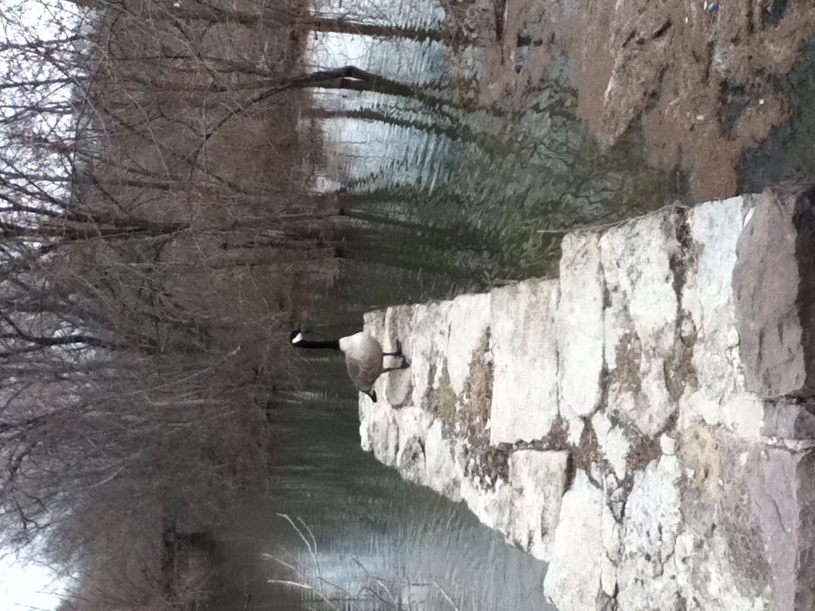
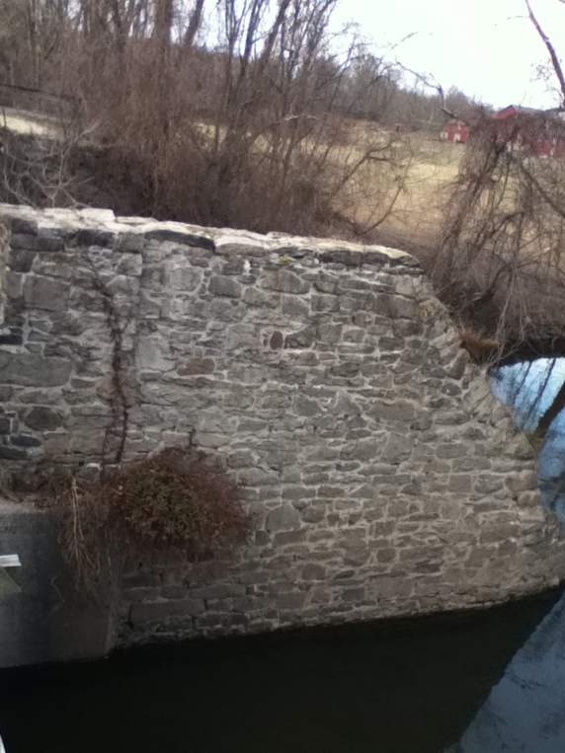
Why bother with Program Evaluation?

Slide 5

What is Program Evaluation?
Thoughtful, systematic collection and analysis of information about activities, characteristics and outcomes of programs, for use by specific people, to reduce uncertainties and inform decisions.
Bruner Foundation
Rochester, New York

Slide 6
What is Program Evaluation?
Thoughtful, systematic collection and analysis of information
Bruner Foundation
Rochester, New York

Slide 7
What is Program Evaluation?
Thoughtful, systematic collection and analysis of information
Bruner Foundation
Rochester, New York

Slide 8
What is Program Evaluation?
Thoughtful, systematic collection and analysis of information about activities, characteristics and outcomes of programs,
Bruner Foundation
Rochester, New York

Slide 9
What is Program Evaluation?
Thoughtful, systematic collection and analysis of information about activities, characteristics and outcomes of programs, for use by specific people,
Bruner Foundation
Rochester, New York

Slide 10
What is Program Evaluation?
Thoughtful, systematic collection and analysis of information about activities, characteristics and outcomes of programs, for use by specific people, to reduce uncertainties and inform decisions.
Bruner Foundation
Rochester, New York

Slide 11

Evaluation Strategy Clarification
◆ All Evaluations Are:
  Partly social
  Partly political
  Partly technical
◆ Both qualitative and quantitative data can be collected and used and both are valuable.
◆ There are multiple ways to address most evaluation needs.
◆ Different evaluation needs call for different designs, data and data collection strategies.
Bruner Foundation
Rochester, New York

Slide 12
What do you need to do to conduct Evaluation?
Specify key evaluation questions
Specify an approach (evaluation design)
Apply evaluation logic
Collect and analyze data
Summarize and share findings
Bruner Foundation
Rochester, New York

Slide 13
What do you need to do to conduct Evaluation?
Specify key evaluation questions
Specify an approach (evaluation design)
Apply evaluation logic
Collect and analyze data
Summarize and share findings
Bruner Foundation
Rochester, New York

Slide 14
Evaluation Questions
Focus and drive the evaluation.
Should be carefully specified and agreed upon in advance of other evaluation work.
Generally represent a critical subset of information that is desired.
Bruner Foundation
Rochester, New York

Slide 15
Community-Based Falls Prevention
The Community-Based Falls Prevention Project (CBFPP) is a three-year pilot developed as a strategy to address a critical factor influencing sustained health and quality of life for older adults. It allows organizations that serve the same individuals to better utilize community and medical resources to strengthen preventative care for older adults.
Lifespan of Greater Rochester in collaboration with the University of Rochester’s Center for Primary Care (URMC) sought to develop and implement a focused falls prevention program to reduce falls and the risk of falls in the region’s 65 and older population.
Target Population: all 34,000 URMC Primary Care patients 65 and older. These patients are cared for by 107 physicians in 23 URMC practices serving Monroe, Livingston and contiguous counties.
Bruner Foundation
Rochester, New York

Slide 16
Community-Based Falls Prevention
Educate primary care providers and primary care teams about fall risk and prevention.
Implement a protocol and triage system to assess risk of falling for individuals 65+ and develop plans to address risk.
Integrate teams of Lifespan staff with teams from URMC primary care through regular meetings
Create a scalable, reproducible model for integration among community based programs and a care delivery system.
Design and implement an electronic interface between Lifespan and URMC for the purpose of facilitating referrals and flow of relevant clinical information.
Increase URMC patient participation in Lifespan’s Matter of Balance Program and utilization of the Lifespan’s Home Safety program.
Bruner Foundation
Rochester, New York

Slide 17
Evaluation Questions: EXAMPLE
To what extent do partners meet their project objectives to collaboratively assess and address fall risk among the targeted patient population?
What challenges and accomplishments unfold as the program is implemented? What strategies and pitfalls can inform replications of future collaborative efforts?
How and to what extent are Medium and High Risk patients assisted by the Matter of Balance, Home Safety, and Clinical Pharmacist Consultation interventions?
To what extent are fall rate and fall severity reduced through collaborative project efforts?
Bruner Foundation
Rochester, New York

Slide 18
Evaluation Question Criteria
It is possible to obtain data to address the questions.
There is more than one possible “answer” to the question.
The information to address the questions is wanted and needed.
It is known how resulting information will be used internally (and externally).
The questions are aimed at changeable aspects of activity.
Bruner Foundation
Rochester, New York

Slide 19
Evaluative
Thinking

Slide 20
What do you need to do to conduct Evaluation?
Specify key evaluation questions
Specify an approach (evaluation design)
Apply evaluation logic
Collect and analyze data
Summarize and share findings
Bruner Foundation
Rochester, New York

Slide 21
What do you need to do to conduct Evaluation?
Specify key evaluation questions
Specify an approach (evaluation design)
Apply evaluation logic
Collect and analyze data
Summarize and share findings
Bruner Foundation
Rochester, New York

Slide 22
Good Evaluation Designs
Include the Following
 Summary information about the program
 The questions to be addressed by the evaluation
 The data collection strategies that will be used
 The individuals who will undertake the activities
 When the activities will be conducted
 The products of the evaluation (who will receive them and how they should be used)
 Projected costs to do the evaluation
Bruner Foundation
Rochester, New York

Slide 23
Increasing Rigor in Program Evaluation
  Mixed methodologies
  Multiple sources of data
  Multiple points in time
Bruner Foundation
Rochester, New York

Slide 24
Evaluation Design Excerpt
In-depth interviews with key collaborators to determine implementation challenges and accomplishments.
Independent review of automated communication portal strategies (electronic interface) and discussions with users regarding usefulness and limitations.
Independent review of Matter of Balance intake and feedback surveys for a sample of target population participants.
Independent review of Home Safety implementation records and recipient feedback surveys for a sample of target population participants.
Independent review of patient assessment and fall incidence reports.
Bruner Foundation
Rochester, New York

Slide 25
Evaluation Design Excerpt
EVALUATION PLAN: CBFPP
Submitted to: Lifespan Submitted By: Anita Baker, Evaluation Services
 |  | All units are days
TASK | Time | AB | JB | LS | URMC
EVALUATION UPDATES
Finalize Year 1 Report and disseminate to stakeholders | Fall 2014 | NO CHARGE
Check in regarding design/updates | January 2015 | 0.15 |  | ✓
Attend partnership meeting, follow-up with Lifespan staff | March 2, 2015 | 0.50 |  | ✓ | ✓
COLLECT AND ANALYZE DATA
Develop and administer MOB Volunteer Survey | March/April 2015 |  | 1.00 | ✓
Develop and administer CM Survey | March/April 2015 | 0.25 | 0.50 |  | ✓
Collect and summarize annual MOB results* | March/April 2015 | 0.50
Collect and summarize annual HSH results | March/April 2015 | 0.50
Collect and analyze HSH client surveys | March/April 2015 |  | 0.50
Collect and summarize annual Fall Rate data and follow-up data | March/April 2015 | 0.50 |  | ✓ | ✓
Interview and analyze feedback from URMC partners** | March/April 2015 | 0.50 |  |  | ✓
REPORTS
Develop Draft Annual Report *** | by May 10, 2015 | 1.75 |  | ✓ | ✓
Develop Final Report | by May 31, 2015 | 0.50 |  | ✓
Oversight (including phone meetings with project director, URMC, GRHF as needed) |  | 0.25
TOTAL LABOR DAYS |  | 5.40 | 2.00
Bruner Foundation
Rochester, New York

Slide 26

Things to Ponder
What are you trying to achieve?
When are data available?
From what source?
How can you use data internally and externally?
Anita M. Baker: Evaluation Services

Slide 27
What do you need to do to conduct Evaluation?
Specify key evaluation questions
Specify an approach (evaluation design)
Apply evaluation logic
Collect and analyze data
Summarize and share findings
Bruner Foundation
Rochester, New York

Slide 28
What do you need to do to conduct Evaluation?
Specify key evaluation questions
Specify an approach (evaluation design)
Apply evaluation logic
Collect and analyze data
Summarize and share findings
Bruner Foundation
Rochester, New York

Slide 29

Logical Considerations
Think about the results you want.
Decide what strategies will help you achieve those results?
Think about what inputs you need to conduct the desired strategies.
Specify outcomes, identify indicators and targets.**
DECIDE IN ADVANCE,
HOW GOOD IS GOOD ENOUGH
5. Document how services are delivered.
6. Evaluate actual results (outcomes).
Bruner Foundation
Rochester, New York

Slide 30
Outcomes
  Changes in attitudes, behavior, skills, knowledge, condition or status.
  Must be:
  Realistic and attainable
  Related to core business
  Within program’s sphere of influence
Bruner Foundation
Rochester, New York

Slide 31
Outcomes: Reminders
  Time-sensitive
  Programs have more influence on more immediate outcomes
  Usually more than one way to get an outcome
  Closely related to program design; program changes usually = outcome changes
  Positive outcomes are not always improvements (maintenance, prevention)
Bruner Foundation
Rochester, New York

Slide 32
Indicators
  Specific, measurable characteristics or changes that represent achievement of an outcome.
  Indicators are:
  Directly related to the outcome, help define it
  Specific, measurable, observable, seen, heard, or read
Bruner Foundation
Rochester, New York

Slide 33
Indicator: Reminders
  Most outcomes have more than one indicator
  Identify the set of indicators that accurately signal achievement of an outcome (get stakeholder input)
  When measuring prevention, identify meaningful segments of time, check indicators during that time
  Specific, Measurable, Achievable, Relevant,Timebound (SMART)
Bruner Foundation
Rochester, New York

Slide 34

Targets
  Specify the amount or level of outcome attainment expected, hoped for or required.
  Targets can be set:
  Relative to external standards (when available)
  Past performance/similar programs
  Professional hunches
Bruner Foundation
Rochester, New York

Slide 35
Target: Reminders
  Targets should be specified in advance, require buy in, and may be different for different subgroups.
  Carefully word targets so they are not over or under-ambitious, make sense, and are in sync with time frames.
  If target indicates change in magnitude – be sure to specify initial levels and what is positive.
Bruner Foundation
Rochester, New York

Slide 36
Outcome, Indicator, Target - EXAMPLE
Outcome
Participants will be actively involved in program activities
Indicators
At least 500 participants will be enrolled each month.
Participants will attend 70% or more of all available sessions, or at least 8 times/month
At least half of participants will volunteer in 100 or more hours of community service per cycle.
Bruner Foundation
Rochester, New York

Slide 37
Outcome, Indicator, Target - EXAMPLE
Outcome | Indicators
65% of clients show slowed or prevented disease progression at 6 and 12 months | Sustained CD4 counts within 50 cells
 | Viral loads <5000
50% of clients with MH issues show improvement at 3 months, by 6 months or at program end. | Maintaining or decreasing mental health distress symptoms from baseline to follow-up using SDS
Bruner Foundation
Rochester, New York

Slide 38
Outcome, Indicator, Target - EXAMPLE
Outcome | Indicators
College students in peer study groups will receive the support and assistance they need and will obtain post-secondary degrees. | At least 75% of participating students will report they get help from and feel supported by their peer study group.
 | All participating freshman students who feel supported enroll for sophomore year
 | More than 40% of eligible peer group participants graduate within 6 years.
Bruner Foundation
Rochester, New York

Slide 39
CBFPP Targets
Program Outcome | Indicators/Targets
Effective fall-risk preventive care is provided for all URMC older adult patients. | At least 20,000 patients 60 or older will be screened using the MAHC 10 Fall Risk Assessment
Fall rate will decline among the target participants | Baseline fall rate of 28% among URMC older patients will be reduced to 21% of all screened patients.
Bruner Foundation
Rochester, New York

Slide 40
CBFPP Targets
Program Outcome | Indicators/Targets YR 1
Effective fall-risk preventive care is provided for all URMC older adult patients. | At least 20,000 patients 60 or older will be screened using the MAHC 10 Fall Risk Assessment | 27, 663 Screened
Fall rate will decline among the target participants | Baseline fall rate of 28% among URMC older patients will be reduced to 21% of all screened patients. | Fall rate = 24%
Bruner Foundation
Rochester, New York

Slide 41
Evaluative
Thinking

Slide 42
Outcomes, Indicators and Targets: Examples
PROGRAM | Services/ Activities | Outcomes | Indicators | Target
FINANCIAL MANAGEMENT | 5 financial management workshops | Participants enhance financial skills | Participants open bank Accounts | 80% of participants have bank accounts
SUPPORTIVE HOUSING | Reduced rent, support group, case management | Clients achieve housing stability | Timely rent payments, sustained tenancy | 60% of clients remain in housing, without arrearages for at least 6 months
HOMEWORK HELP CLUB | Daily , 1-hour HW assistance (with certified instructors) | Participants improve HW grades | Frequency of on-time homework completion. | Most (85% or more) participants will complete at least 75% of their homework on time.
EMPLOYMENT AND TRAINING | Hard Skills Classes and Placement assistance | Sustained employment Stable income | Employment Retention rates for 6 month period | 70% of participants will retain a job paying $8/hr or more for at least 6 months
IMMIGRANT SERVICES | ESL CLASSES | Increased knowledge of English | Improved ESL Test Scores | 50% of clients will increase score on ESL test by one level

Slide 43
What do you need to do to conduct Evaluation?
Specify key evaluation questions
Specify an approach (evaluation design)
Apply evaluation logic
Collect and analyze data
Summarize and share findings
Bruner Foundation
Rochester, New York

Slide 44
What do you need to do to conduct Evaluation?
Specify key evaluation questions
Specify an approach (evaluation design)
Apply evaluation logic
Collect and analyze data
Summarize and share findings
Bruner Foundation
Rochester, New York

Slide 45
How are evaluation data collected?
All have limitations and benefits
All can be used to collect either quantitative or qualitative data
Require preparation on the front end:
  Instrument Development and testing
  Administration plan development
  Analysis plan development
Surveys
Interviews
Observations
Record Reviews
Bruner Foundation
Rochester, New York

Slide 46
Surveys
Series of items with pre-determined response choices
Can be completed by administrator or respondents
Can be conducted
  “paper/pencil”
  phone, internet (e-survey)
  using alternative strategies
Instruments are called – surveys, “evaluations,” questionnaires
USE SURVEYS TO:
Study attitudes and perceptions
Collect self-reported assessment of changes in response to program
Collect program assessments
Collect some behavioral reports
Test knowledge
Determine changes over time.
PRE
POST
GRAND
CLAIMS
Bruner Foundation
Rochester, New York

Slide 47
Survey Results Example: CBFRPP
Table 4: Matter of Balance Participant Reports (n=218)
% of respondents who are Sure or Very Sure they can . . . | First M.O.B. Class | Last M.O.B. Class | Difference
Protect themselves if they fall | 34% | 75% | +41
Become more steady on their feet | 52% | 88% | +36
Find a way to reduce falls | 61% | 92% | +31
Find a way to get up if they fall | 59% | 84% | +25
Increase physical strength | 68% | 92% | +24
Table 5: Matter of Balance Participant Feedback (n=228)
% of respondents who are Sure or Very Sure they can . . . | Agree | Strongly Agree | TOTAL
Leaders were well prepared | 19% | 81% | 100%
Classes were well organized | 26% | 74% | 100%
I would recommend this class to a friend or relative | 29% | 70% | 99%
Bruner Foundation
Rochester, New York

Slide 48
Evaluative
Thinking

Slide 49
Assessing Survey Instruments
    Are questions comprehensive without duplication, exhaustive without being exhausting?
    Do answer choices match question stem, provide coverage, avoid overlap?
    Are other data needs (e.g., characteristics of respondent) addressed?
    Do order and formatting facilitate response? Are directions clear?
    Does the survey have face validity?
Bruner Foundation
Rochester, New York

Slide 50

Things to Think about Before Administering a Survey
Target group: who, where, sampling?
Respondent assistance, A/P consent
Type of survey, frequency of administration
Anonymity vs. Confidentiality
Specific fielding strategies, incentives?
Time needed for response
Tracking administration and response
Data analysis plans
Storing and maintaining confidentiality
Bruner Foundation
Rochester, New York

Slide 51
Interviews:
One-sided conversation with questions mostly pre-determined, but open-ended.
Respondent answers in own terms.
Can be conducted
  in person
  on phone
  one-on-one, or groups
Instruments are called – protocols, schedules or guides
USE INTERVIEWS TO:
Study attitudes and perceptions
Collect self-reported assessment
of changes in response to program
Collect program assessments
Document program implementation
Determine changes over time.
Bruner Foundation
Rochester, New York

Slide 52

Excerpts from Partner Interviews
Lifespan recognizes it can’t do everything on its own. We need increased access to patients that would benefit from our services. We needed to partner with a medical provider and to establish that our services are meaningful and viable to the medical community. Lifespan COO
It was clear to us that the medical home would only thrive with a robust medical neighborhood - we need to partner with outside agencies. In this case we need specifically to partner with Lifespan – a group of people who do this all the time, have figured this out and have programs in place, but need a steady stream of referrals. Both organizations had something each other needed. Culturally the two organizations are very well suited, and the partnership just flourished from there. URMC Medical Director for the URMC Center for Primary Care
Bruner Foundation
Rochester, New York

Slide 53
Observations:
Observations are conducted to view and hear actual program activities.
Users of reports will know what and how events occur.
Can be focused on
  programs overall
  participants
  pre-selected features
Instruments are called – protocols, guides, checklists
USE OBSERVATIONS TO:
Document program implementation
Witness levels of skill/ability, program practices, behaviors Determine changes over time.
Bruner Foundation
Rochester, New York

Slide 54


Slide 55

Record Reviews:
Accessing existing internal information, or information collected for other purposes.
Can be focused on
  own records
  records of other orgs
  adding questions to existing docs
Instruments are called – protocols
USE REC REVIEW TO:
Collect some behavioral reports
Conduct tests, collect test results
Verify self-reported data
Determine changes over time
Bruner Foundation
Rochester, New York

Slide 56
What kinds of data can you collect through record reviews?
Background information about participants (e.g., race/ethnicity, age, gender, ed. level, location, living arrangements)
Status information about participants (e.g., whether and how much they are working or volunteering, what their income levels are, how they are insured, whether they have a caregiver, whether they have visited the ED recently)
Behavioral data (e.g., program attendance, program service utilization)
Test results (e.g., medical test results such as MAHC 10 screening, immunization status, TB test results; aptitude test scores)
Other outcome data (e.g., health or psychological assessments, home visit results)
Bruner Foundation
Rochester, New York

Slide 57
Record Review Analysis: Dummy Table
 | CDR | EF | MHA | MS | CENTRAL | TOTAL
Number of Participants
AGE at INTAKE (Convert to %s)
17 and Younger
18 – 21
22 – 34
35 – 49
50 – 64
65 and Older
PRIMARY DISABILITY (%s)
Neurological
Developmental/Cognitive
Physical
Chronic Disease/Illness
Psychiatric
Sensory
Other
Bruner Foundation
Rochester, New York

Slide 58
Record Review Example: Descriptive
 | CDR | EF | MHA | MS | CENTRAL | TOTAL
Number of Participants | 32 | 45 | 33 | 43 | 157 | 310
AGE at INTAKE
17 and Younger | 3% | 4% | 0 | 0 | 10% | 7%
18 – 21 | 0 | 13% | 0 | 0 | 47% | 20%
22 – 34 | 13% | 29% | 19% | 7% | 18% | 17%
35 – 49 | 39% | 27% | 34% | 40% | 28% | 30%
50 – 64 | 36% | 22% | 38% | 47% | 19% | 23%
65 and Older | 10% | 4% | 9% | 7% | 0 | 4%
PRIMARY DISABILITY
Neurological | 22% | 60% | 3% | 98% | 0 | 27%
Developmental/Cognitive | 19% | 31% | 0 | 0 | 78% | 43%
Physical | 6% | 0 | 0 | 0 | 2% | 2%
Chronic Disease/Illness | 3% | 0 | 0 | 0 | 1% | 1%
Psychiatric | 19% | 4% | 97% | 0 | 11% | 19%
Sensory | 9% | 2% | 0 | 0 | 1% | 1%
Other | 22% | 2% | 0 | 2% | 7% | 6%
Bruner Foundation
Rochester, New York

Slide 59
CBFPP Record Review Excerpts
Appendix Table 1: Description of Matter of Balance Participants, 2014
AGE GROUP
60 - 69 | 18%
70 - 79 | 33%
80 or older | 49%
HOUSEHOLD
Live alone | 47%
Live with spouse | 41%
Live with multiple family members | 12%
HEALTH INSURANCE
Medicare | 90%
Medicaid | 10%
Bruner Foundation
Rochester, New York

Slide 60
Location of M.O.B. Participants

Slide 61
CBFPP Record Review Excerpts
Table 2: Fall Incidence and Plan Development, Year 1, By Age Group
 | Total | Assessed |  | Fell |  | Have Plan
 | # | # | % | # | % | # | %
65 to 70 | 14,081 | 9053 | 64% | 1662 | 18% | 1562 | 94%
71 – 75 | 8559 | 6949 | 81% | 1444 | 21% | 1382 | 96%
76 – 80 | 5787 | 4824 | 83% | 1161 | 24% | 1114 | 96%
81 – 85 | 4279 | 3606 | 84% | 1052 | 29% | 1005 | 96%
86 – 90 | 2619 | 2150 | 82% | 773 | 36% | 751 | 97%
91 and above | 1442 | 1087 | 75% | 434 | 40% | 411 | 95%
TOTAL | 36,767 | 27,663 | 75% | 6526 | 24% | 6225 | 95%
Bruner Foundation
Rochester, New York

Slide 62
Evaluative
Thinking

Slide 63
What happens after data are collected?
Data are analyzed according to plans. Results/findings are summarized.
Findings must be converted into a format that can be shared with others.
Action steps should be developed from findings.
“Now that we know _____ we will _____.”
Bruner Foundation
Rochester, New York

Slide 64
Evaluation Example: Findings Yr. 1
Decrease fall incidence: rate went from 28% at baseline to 24% at conclusion of Year 1 (much lower for younger patients — 18% for those 65 – 70, much higher— 40% for those 91 and above).
Increase strength and balance for those at high risk who participate in Matter of Balance: participants reported increased certainty regarding their abilities to protect themselves if they fall, increased steadiness, and able to find ways to reduce falls and get up from falls. Substantially more clients were sure they had increased their physical strength, fewer were allowing fear of falls to impinge on their social activities, and many more (74% compared to 55%) were doing regular exercise.
Increase home safety where needed through modifications: multiple homes were visited and assessed, safety and security improvements were made and clients were satisfied with the service.
Achieve desired utilization of clinical pharmacist consultation and development of appropriate fall-risk responses. Pharmacist was somewhat under-utilized during Year 1. By years end, additional queries were undertaken showing increased risk associated with medications, and structural changes were made to the Pharmacist role so that she would before integrated with the whole program and use would increase.
Bruner Foundation
Rochester, New York

Slide 65
Examples of Recommended Action Steps
Continue to pay attention to age cohorts, medication use, and diabetes care as fall risk assessment is continued.
Ensure that all new practices that join the medical home receive full education about the Falls Prevention Partnership, follow standard practices (especially plan development and referrals when needed), utilize interventions.
Continue exploring program delivery modifications for M.O.B. while maintaining the evidence-based program structure (possibly add more and earlier exercise routines to training).
Continue to focus on outreach, scheduling, reminders, and follow-up to ensure that as many patients as possible avail themselves of the full M.O.B. curriculum, especially given the important reported benefits.
Continue to ensure that all Care Managers are briefed regarding available Home Modification services and make appropriate referrals to maximize utilization of available services
Bruner Foundation
Rochester, New York

Slide 66
Data Tools Choices
 | Google Forms | Survey Monkey | Microsoft Excel | PSPP*
COST | FREE | $228 - $300 PER YEAR | “FREE” | FREE
WEB-BASED | YES | YES | NO | NO
INTERFACE | e-Survey | e-Survey | SPREAD SHEET | SPREAD SHEET
PRINT-READY SURVEYS | YES | YES | NO | NO
ANALYTICAL POWER | Basic Only | Basic + | Basic ++ | Advanced
Bruner Foundation
Rochester, New York

Slide 67
Evaluative
Thinking

